Slide 1
Imagine A world without bullies
Children’s craniofacial association

Slide 2
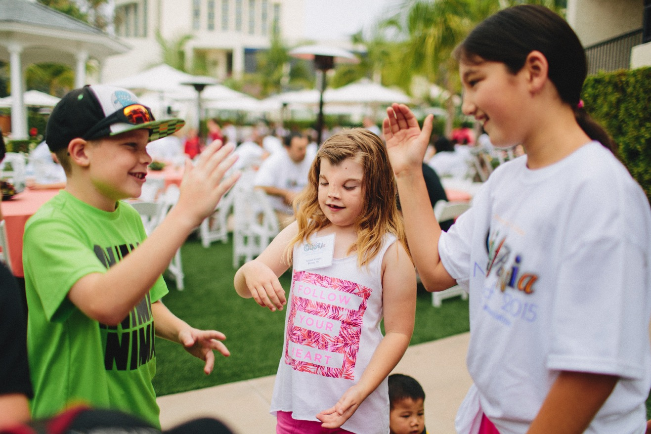
Children’s craniofacial association
We are also known as “CCA,” and “CCA Kids.”

Slide 3
mission
The mission of Children’s Craniofacial Association is empowering and giving hope to individuals and families affected by facial differences.
We envision a world where everyone is accepted for who they are, not how they look.
Notes:
CCA was founded in 1989 and since that time, we’ve continued to reach out and try to connect the craniofacial community.

Slide 4
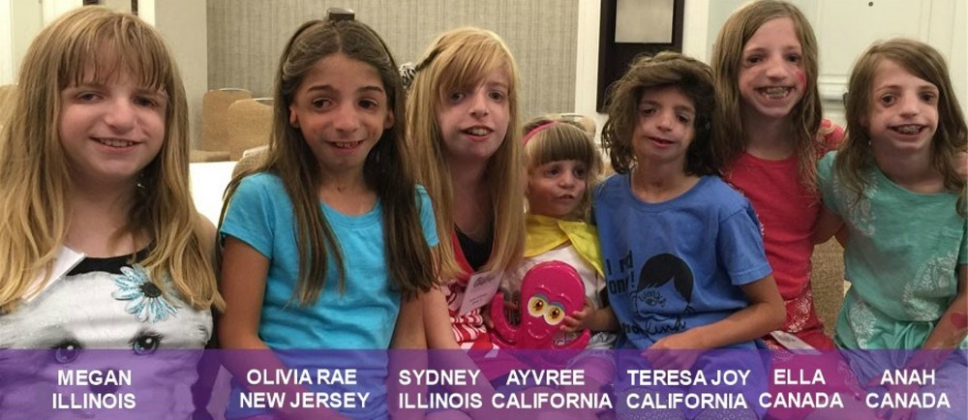
The big three – Main Support programs we offer
Patient Financial Assistance for Medical Travel
Family Networking – including the Annual Family Retreat & Educational Symposium
Educational Outreach via our #ChooseKind Initiative in Schools and Community Groups
Notes:
Throughout the years, we have maintained our newsletter and our financial assistance program and Retreat. In 2012, we added our Choose Kind initiative when the book Wonder was published.

Slide 5
CCA Provides FINANCIAL ASSISTANCE
For families on medical travel, CCA offers financial assistance for travel, lodging, and food
We ask they apply a minimum of 4 weeks before surgery
Simple application process
We award funds based on need, circumstances, and CCA’s budgetary allowance

Slide 6
Family networking
We believe having someone who understands you and your unique journey makes life better
We connect families across the country with similar syndromes, of various ages, to connect with one another
We have dramatically increased our virtual support groups and online offerings so families can connect across distances (and during the COVID-19 pandemic)
Regional gatherings and events, especially during September, Craniofacial Acceptance Month, happen frequently

Slide 7
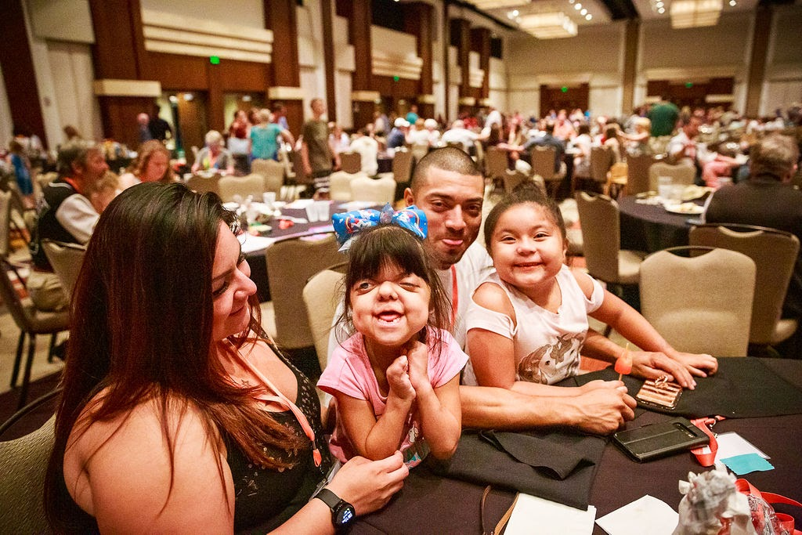

Slide 8
Annual family retreat & educational symposium
Every June, over 600 family members get together to network and support one another, and have a lot of fun at our 4-day Annual Family Retreat
We kick it off with an Educational Symposium featuring medical experts, group sessions, and motivational speakers
We call it a “world without bullies” and our “extended family reunion”
We also award travel scholarships to Retreat, so families who otherwise could not attend, are able to experience Retreat

Slide 9
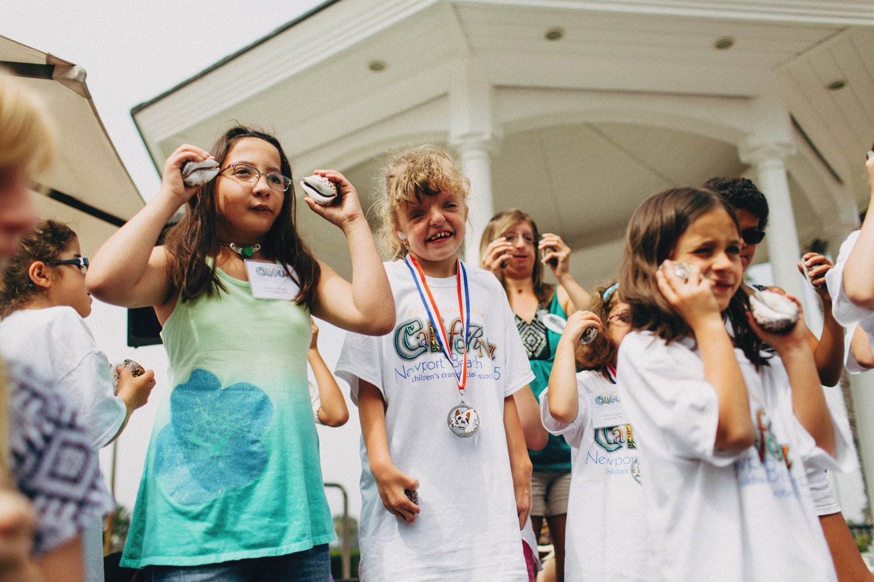

Slide 10
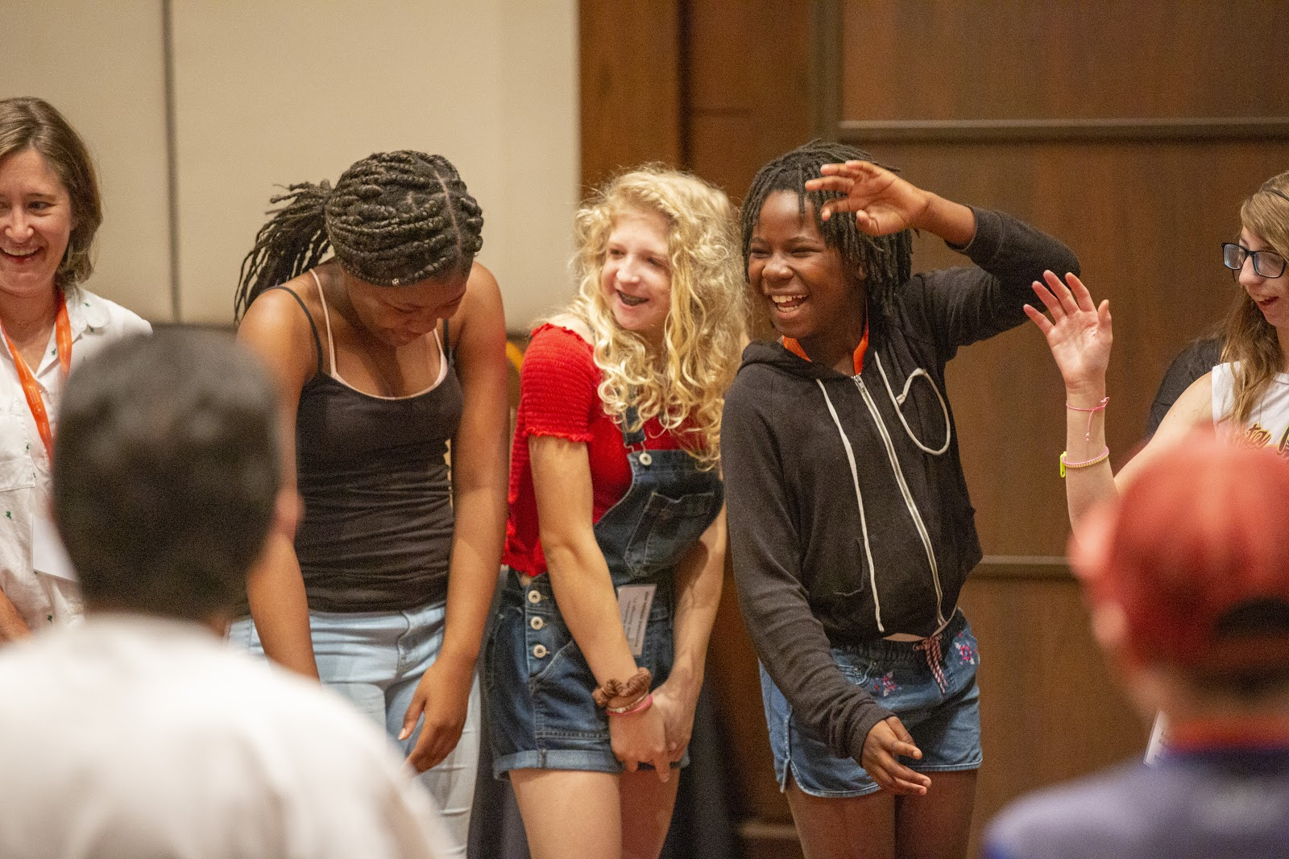

Slide 11
Educational outreach: the #chooseKind initiative
We offer free curriculum for all ages for educators that want to teach tolerance, acceptance, self-confidence, and anti-bullying values to their students
Special edition copies of the book Wonder are available for bulk purchase for schools and libraries, as well as donations for qualified educator requests
Our Speakers Bureau offers talented, trained, volunteer speakers who visit classrooms and speak virtually to students and groups across the country

Slide 12
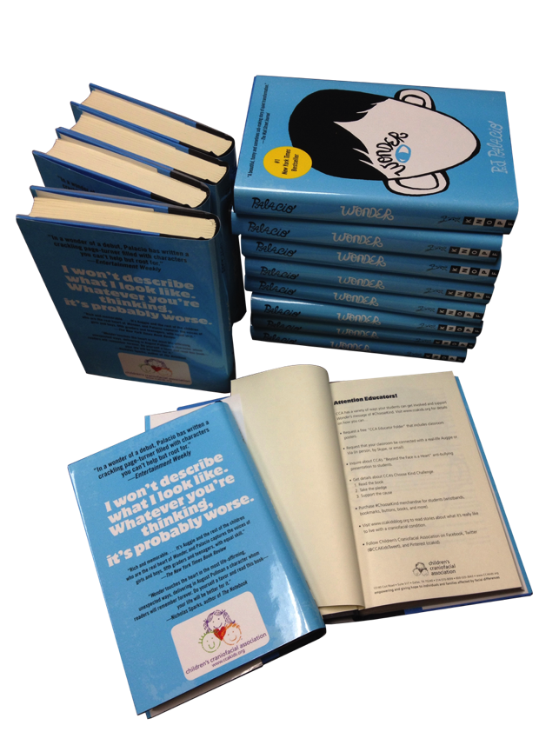
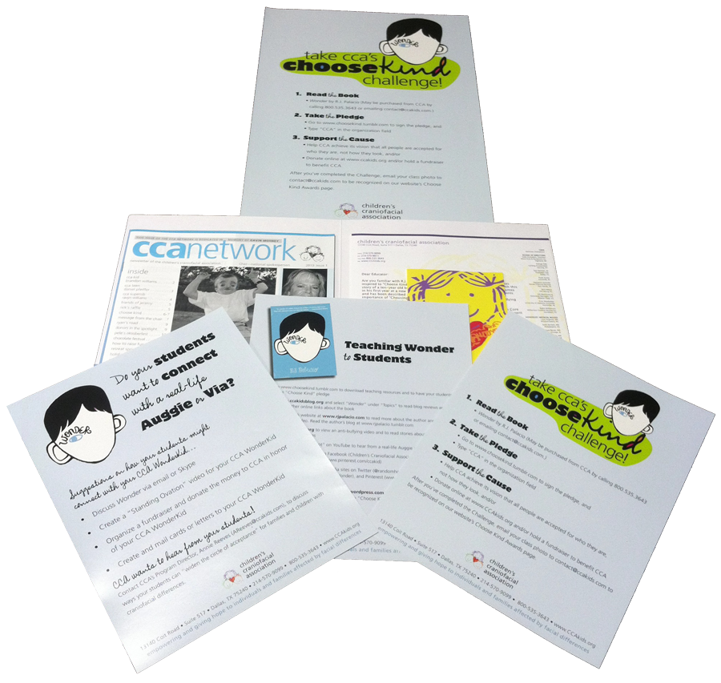

Slide 13
Speakers bureau value
The importance of this program is two-fold:
      A platform of self-advocacy for students with craniofacial conditions
      A universal message that improves relationships in classrooms and families, built on kindness, empathy, and understanding one another

Slide 14
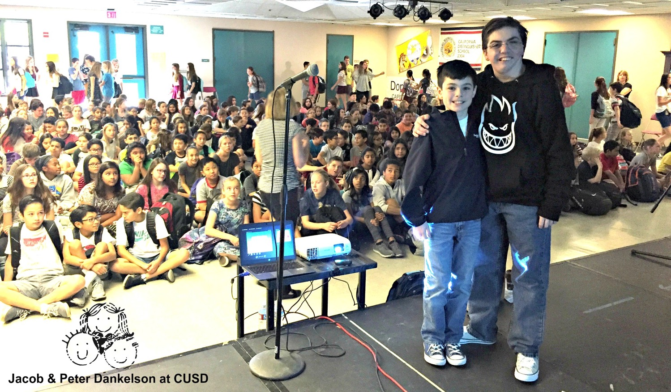

Slide 15
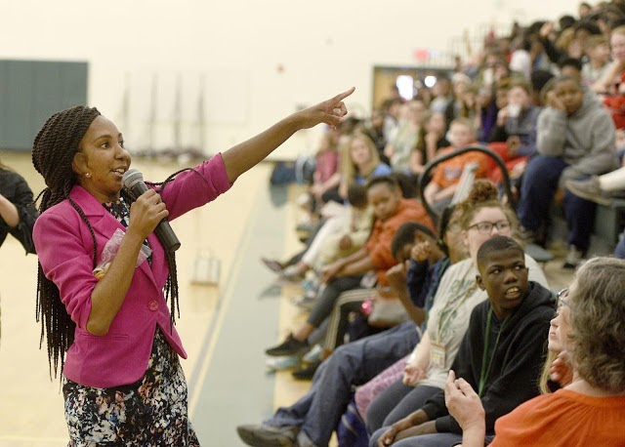

Slide 16
Fundraising – a part of the community
Receiving a diagnosis of any condition can be tough. Sometimes you may feel very alone and even powerless. However, for many CCA families hosting or participating in a fundraising event can bring comfort and healing as well as a sense of community.
Hosting an event or joining an event committee is a commitment to hard work, but you will be rewarded with the community you find and the platform you develop. The connections you make with other families and volunteers in the craniofacial community will be your support, even as you are supporting them.

Slide 17
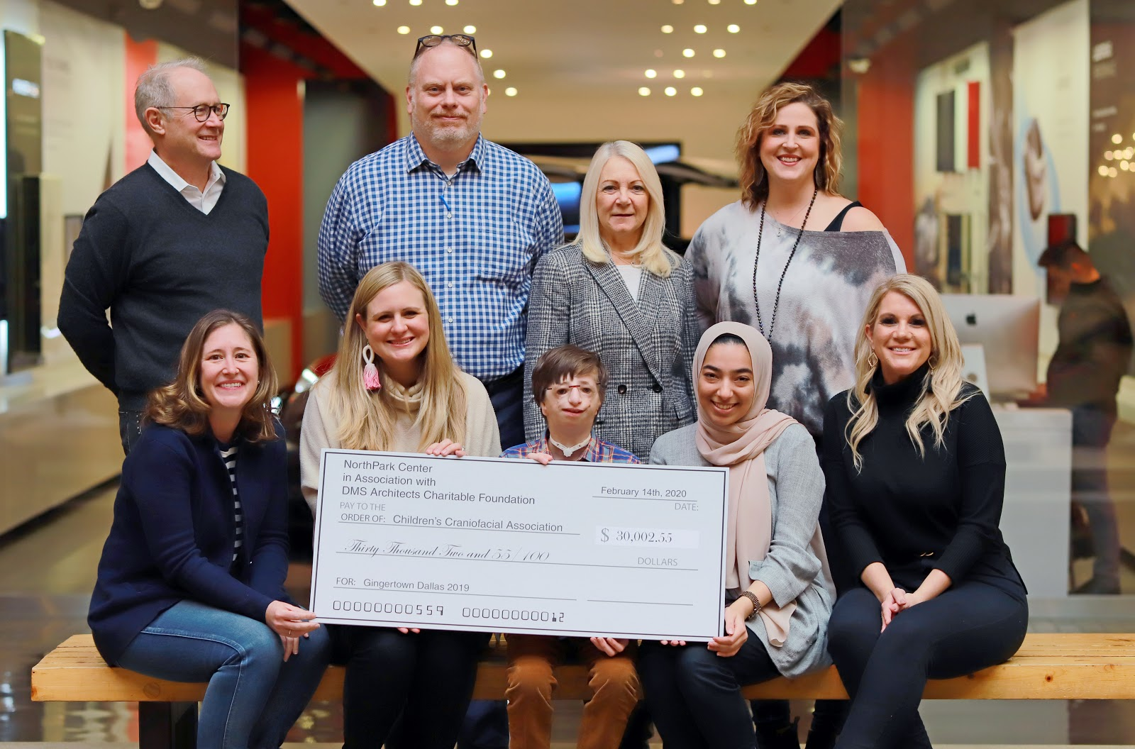

Slide 18
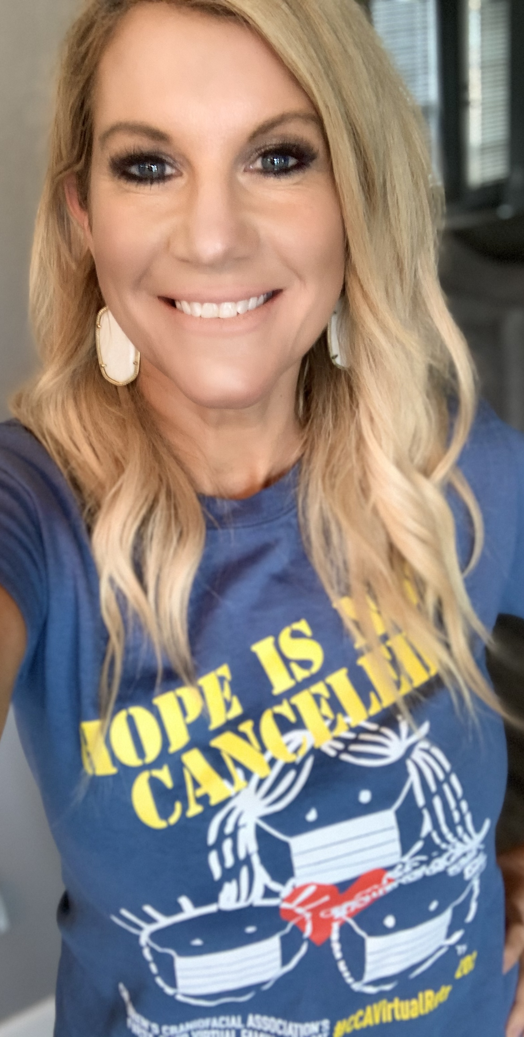
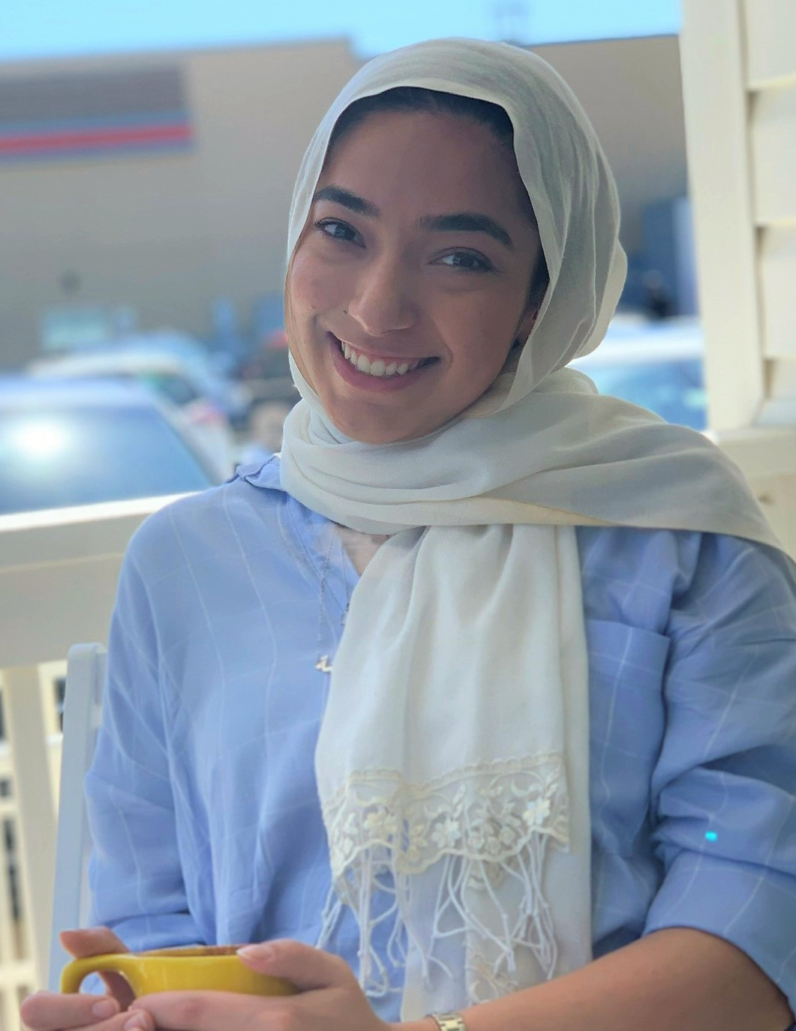
Staff
Annie Reeves
Program Director
Khadija Moten
Outreach Director

Slide 19
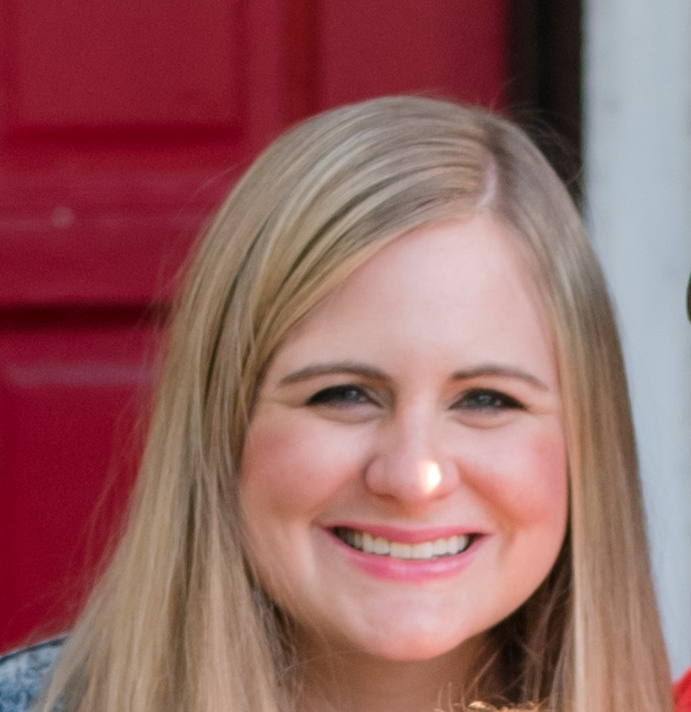
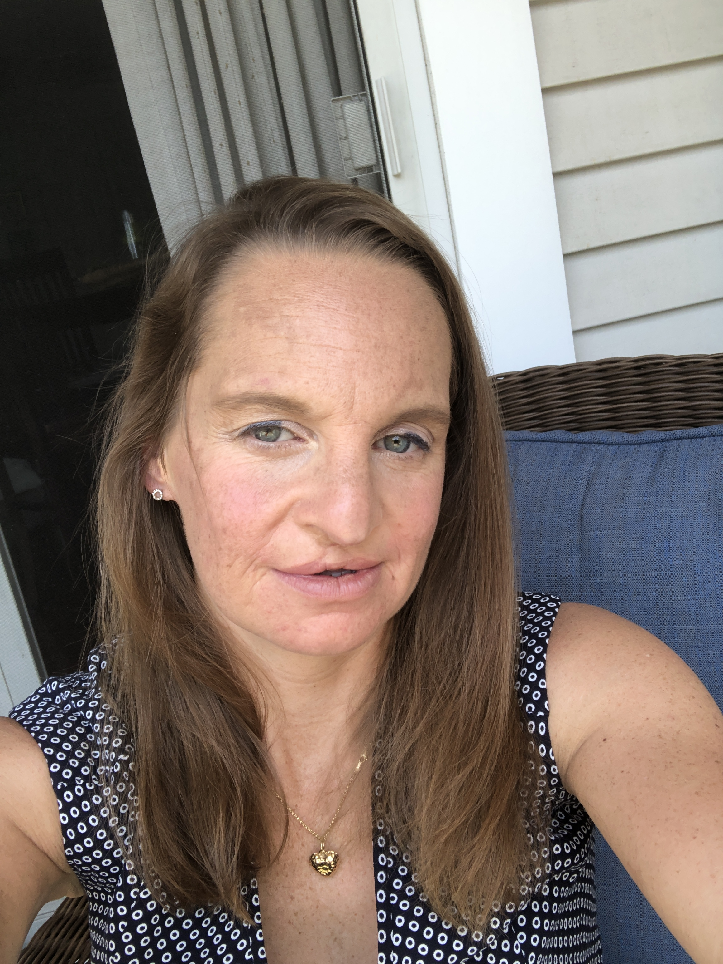
staff
Christine Andler
Director of Development
Kara Jackman
Marketing Coordinator

Slide 20
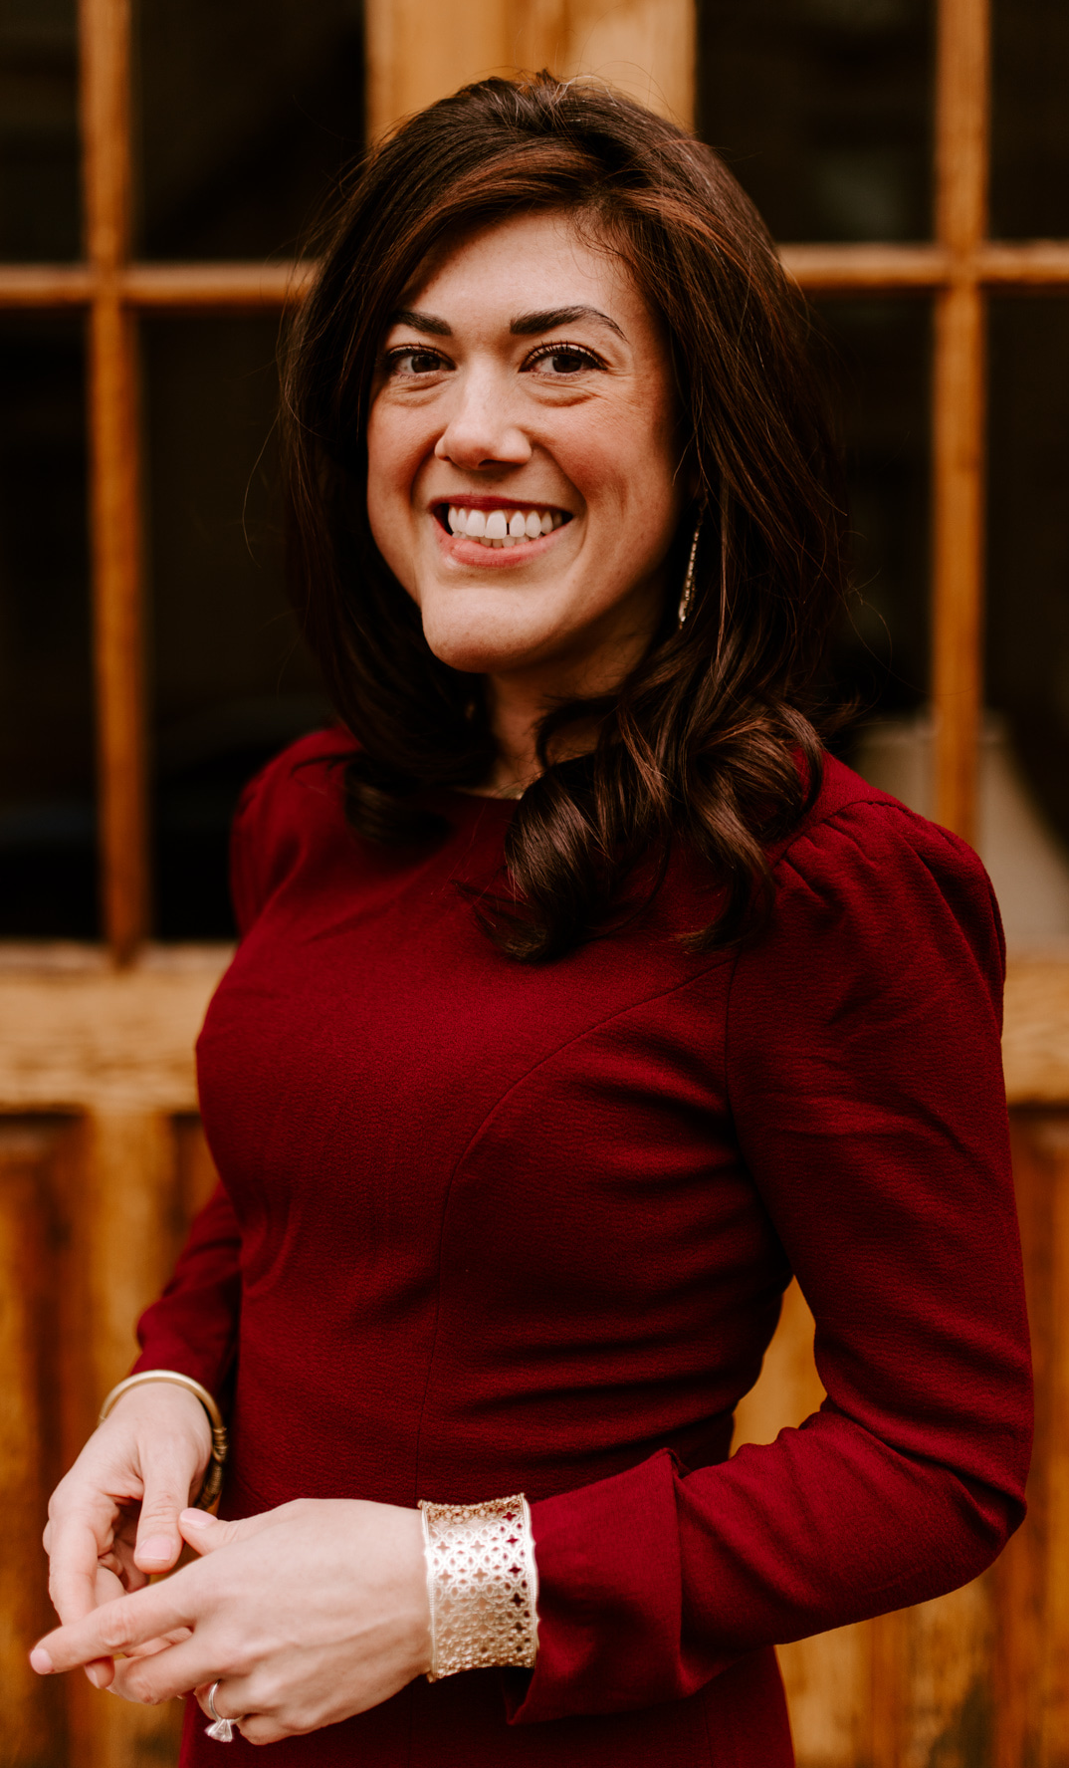
staff
BOARD OF DIRECTORS
Jim Brookshier, MPO, CLPO, San Antonio, TX
Kelly Cunha, Tampa, FL
George Dale, Horseheads, NY
Dede Dankelson, Libertyville, IL
Jay Jewett, JD, Plano, TX
Margaret Lavender, Oklahoma City, OK
Bill Mecklenburg, Coto de Caza, CA
Albert “Chuck” Russell, Santa Fe, NM
Haley Streff, MS, CGC, Houston, TX
Courtney Vysocky, Denver, CO
Steven Weiss, Dallas, TX
Erica Mossholder
Executive Director

Slide 21
How to connect with us
Website www.ccakids.com
Newsletter sign up online!
Blog www.ccakidsblog.com
Facebook www.fb.com/ccakids
Twitter www.twitter.com/ccakidstweet
Instagram www.instagram.com/ccakids
Pinterest https://www.pinterest.com/cca_kids/
LinkedIn https://www.linkedin.com/company/childrens-craniofacial-association
Call 800-535-3643
Email contactCCA@ccakids.com

